Slide 1


Slide 2
Step-by-step Guide on How to Use
An Epilog Laser Cutter (T11C)

Slide 3
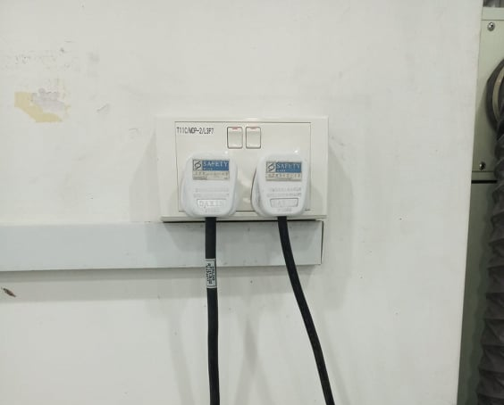
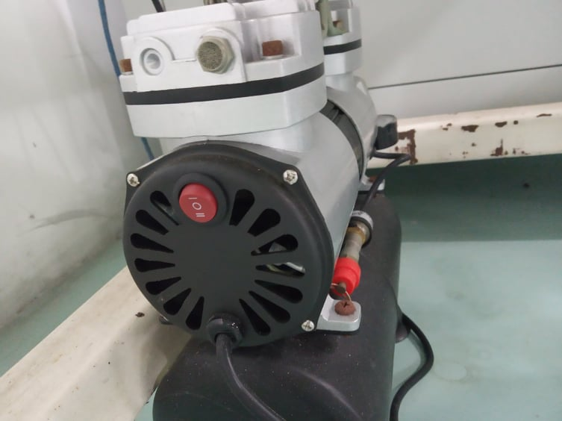
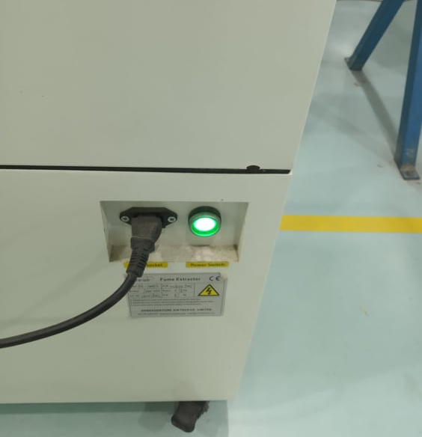
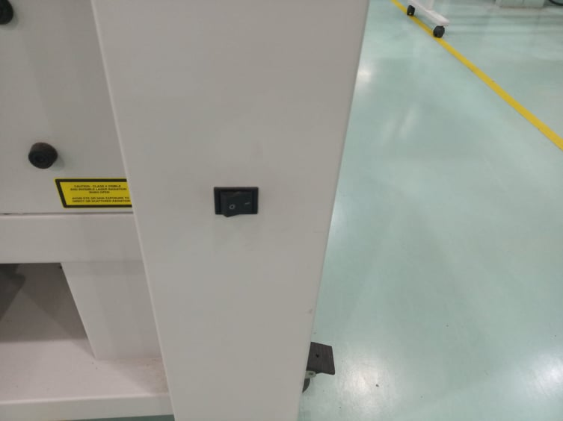
Step 1 (Before Laser Cutting)
Before laser cutting, make sure that you have switched on-
Main switches
Vacuum
Motor
Laser Cutter
1
2
3
4

Slide 4
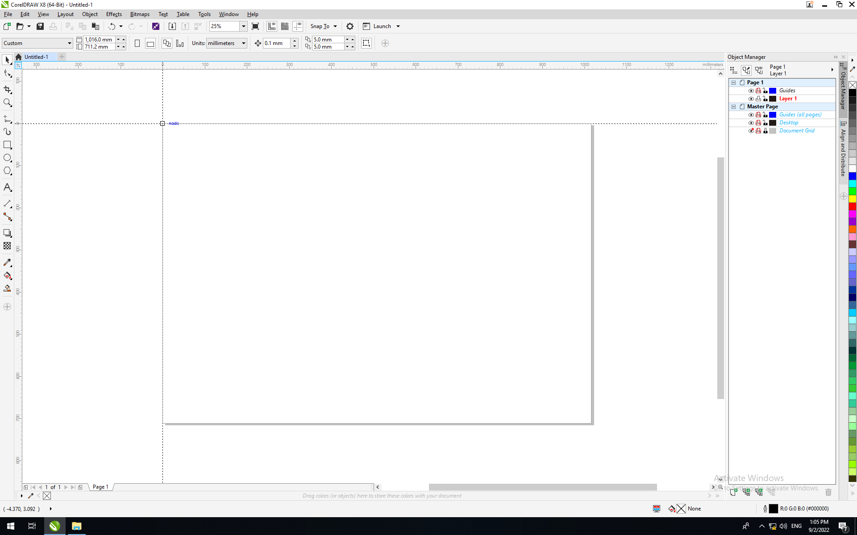
Step 2
Open CorelDraw. Then set the top left corner of the canvas as (0, 0) coordinate. You can do so by going to the icon at the top left corner and dragging to the corner of the canvas.

Slide 5
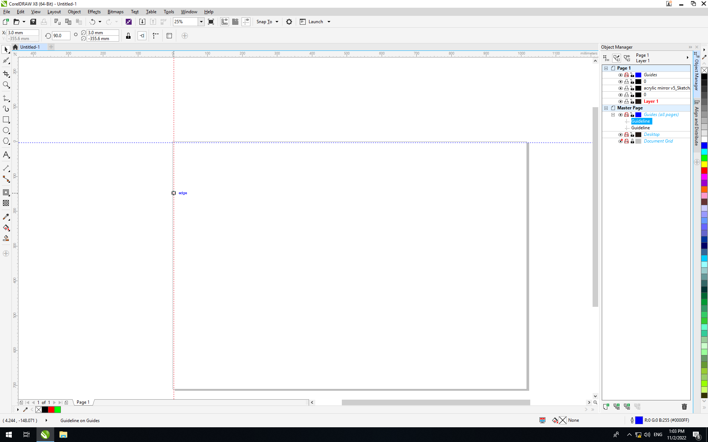
Step 3
Setup guidelines by dragging the horizontal and vertical rulers. Guidelines helps arrange drawings and reduces taking up additional material space. You can check the position of the guidelines by clicking on it. The coordinates can be seen at the top left corner.
COORDINATE
HORIZONTAL
RULER
GUIDLINES
VERTICAL
RULER

Slide 6
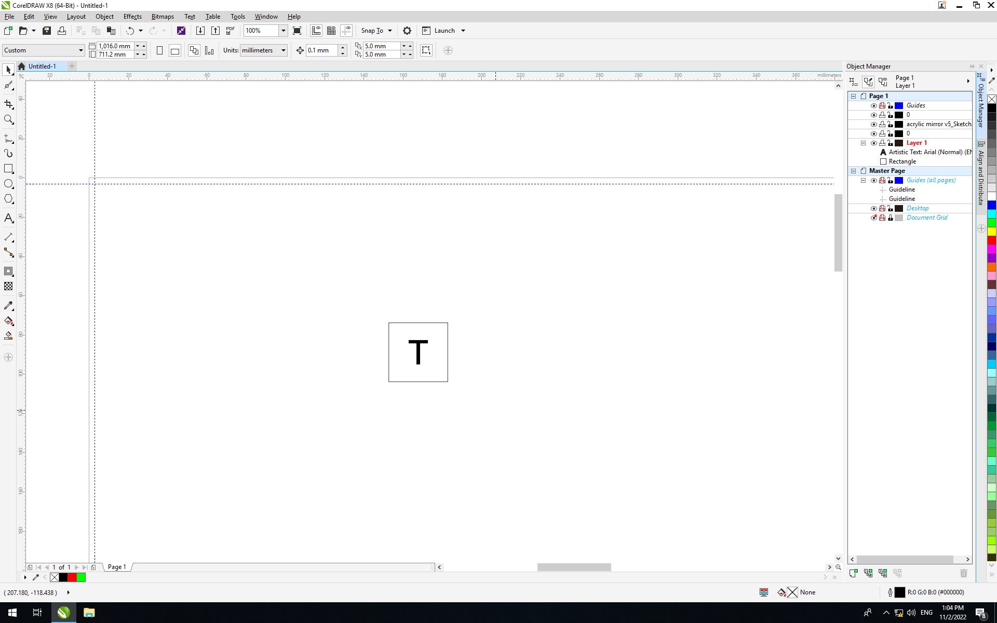
Step 4
Import your file into CorelDraw. Make sure that the file is in one of the formats. (dxf, dwg, svg, pdf and/ or image file(s))
Note: Image files should be in jpg, jpeg or png format. Otherwise, the file will be corrupted when imported into CorelDraw.

Slide 7
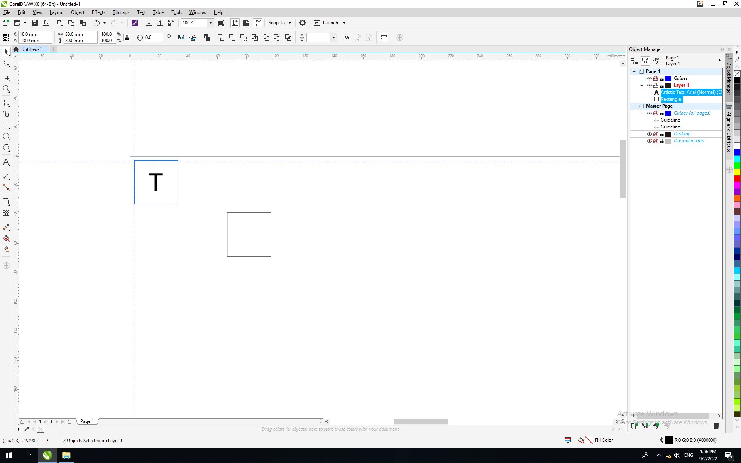
Step 5
Move the imported file to the guidelines. You will see the snap line when the drawing is touching the guidelines. If the snap lines do not appear, make sure that the guideline checkbox has been checked under “Snap To” drop down.
SNAP LINES

Slide 8
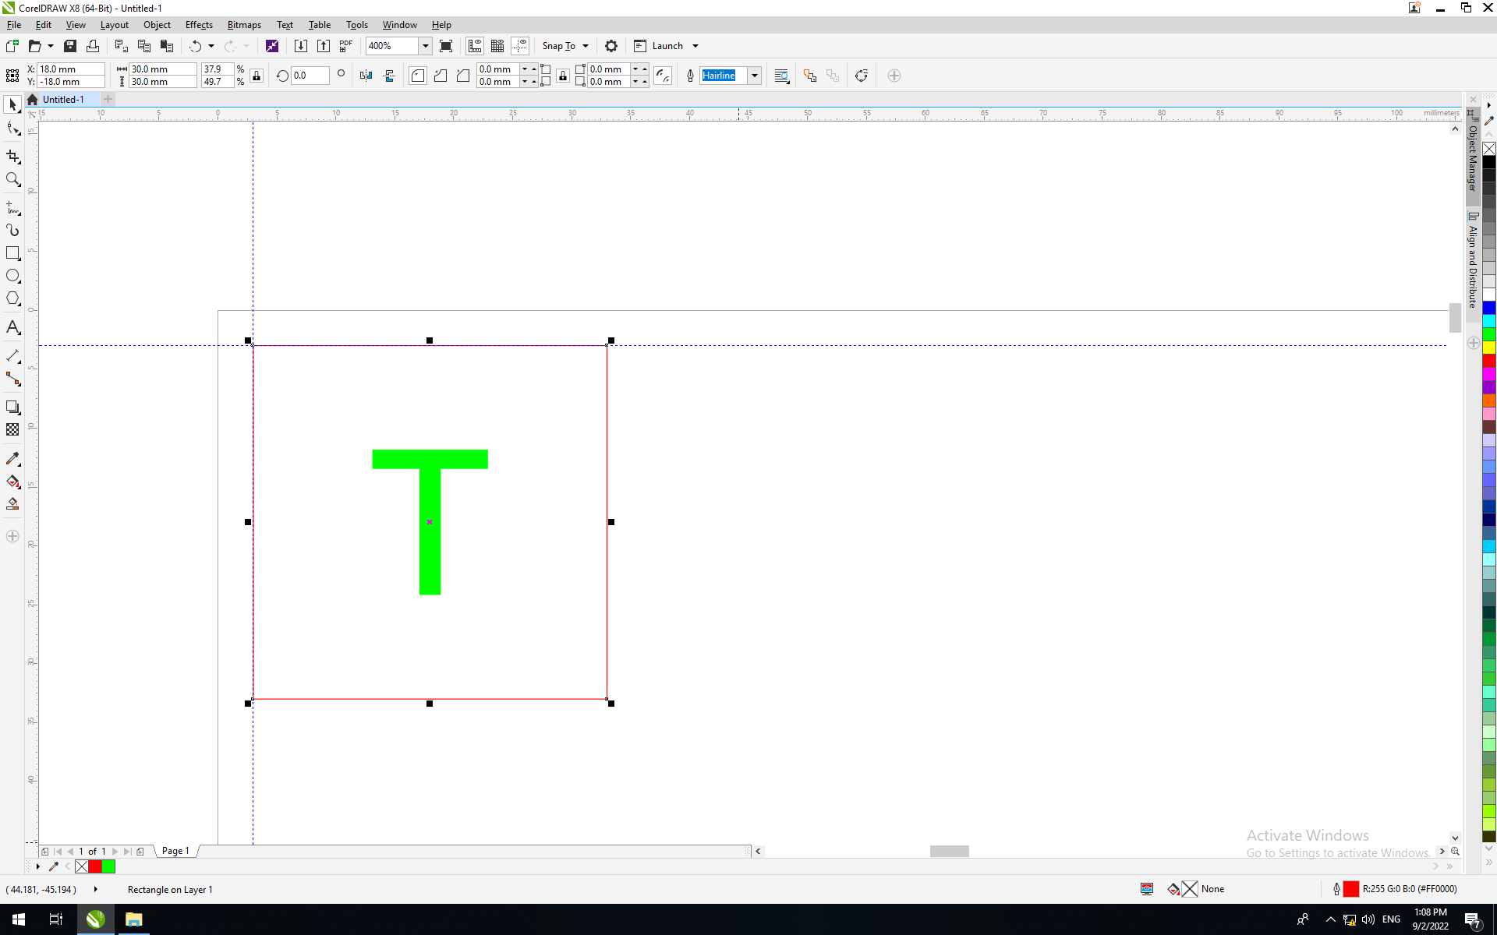
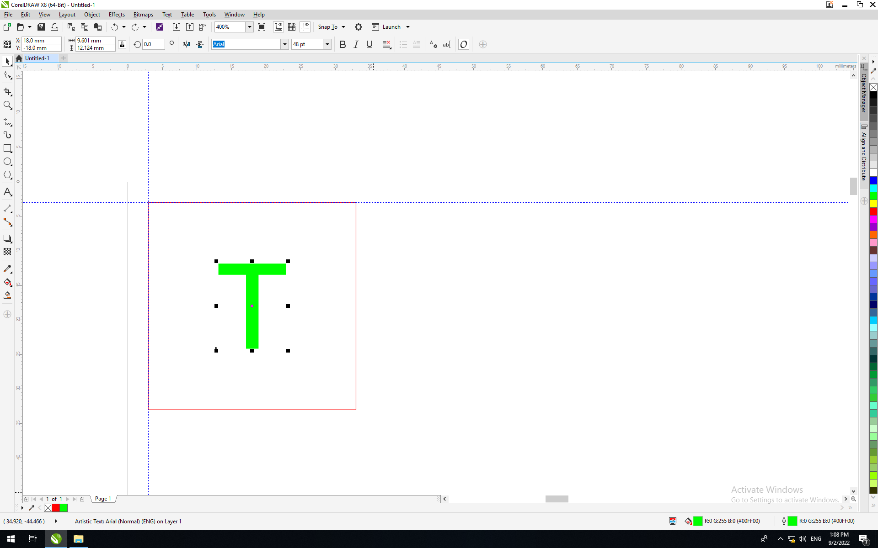
Step 6
Make sure that the line(s) and object(s) have the correct line color and thickness for different cutting settings.
For vector cutting
Lines should be in red, and thickness should be in hairline.
LINE THICKNESS
For raster engraving
Line thickness can be anything other than “None” or “Hairline”. Object(s) color should be in green.

Slide 9
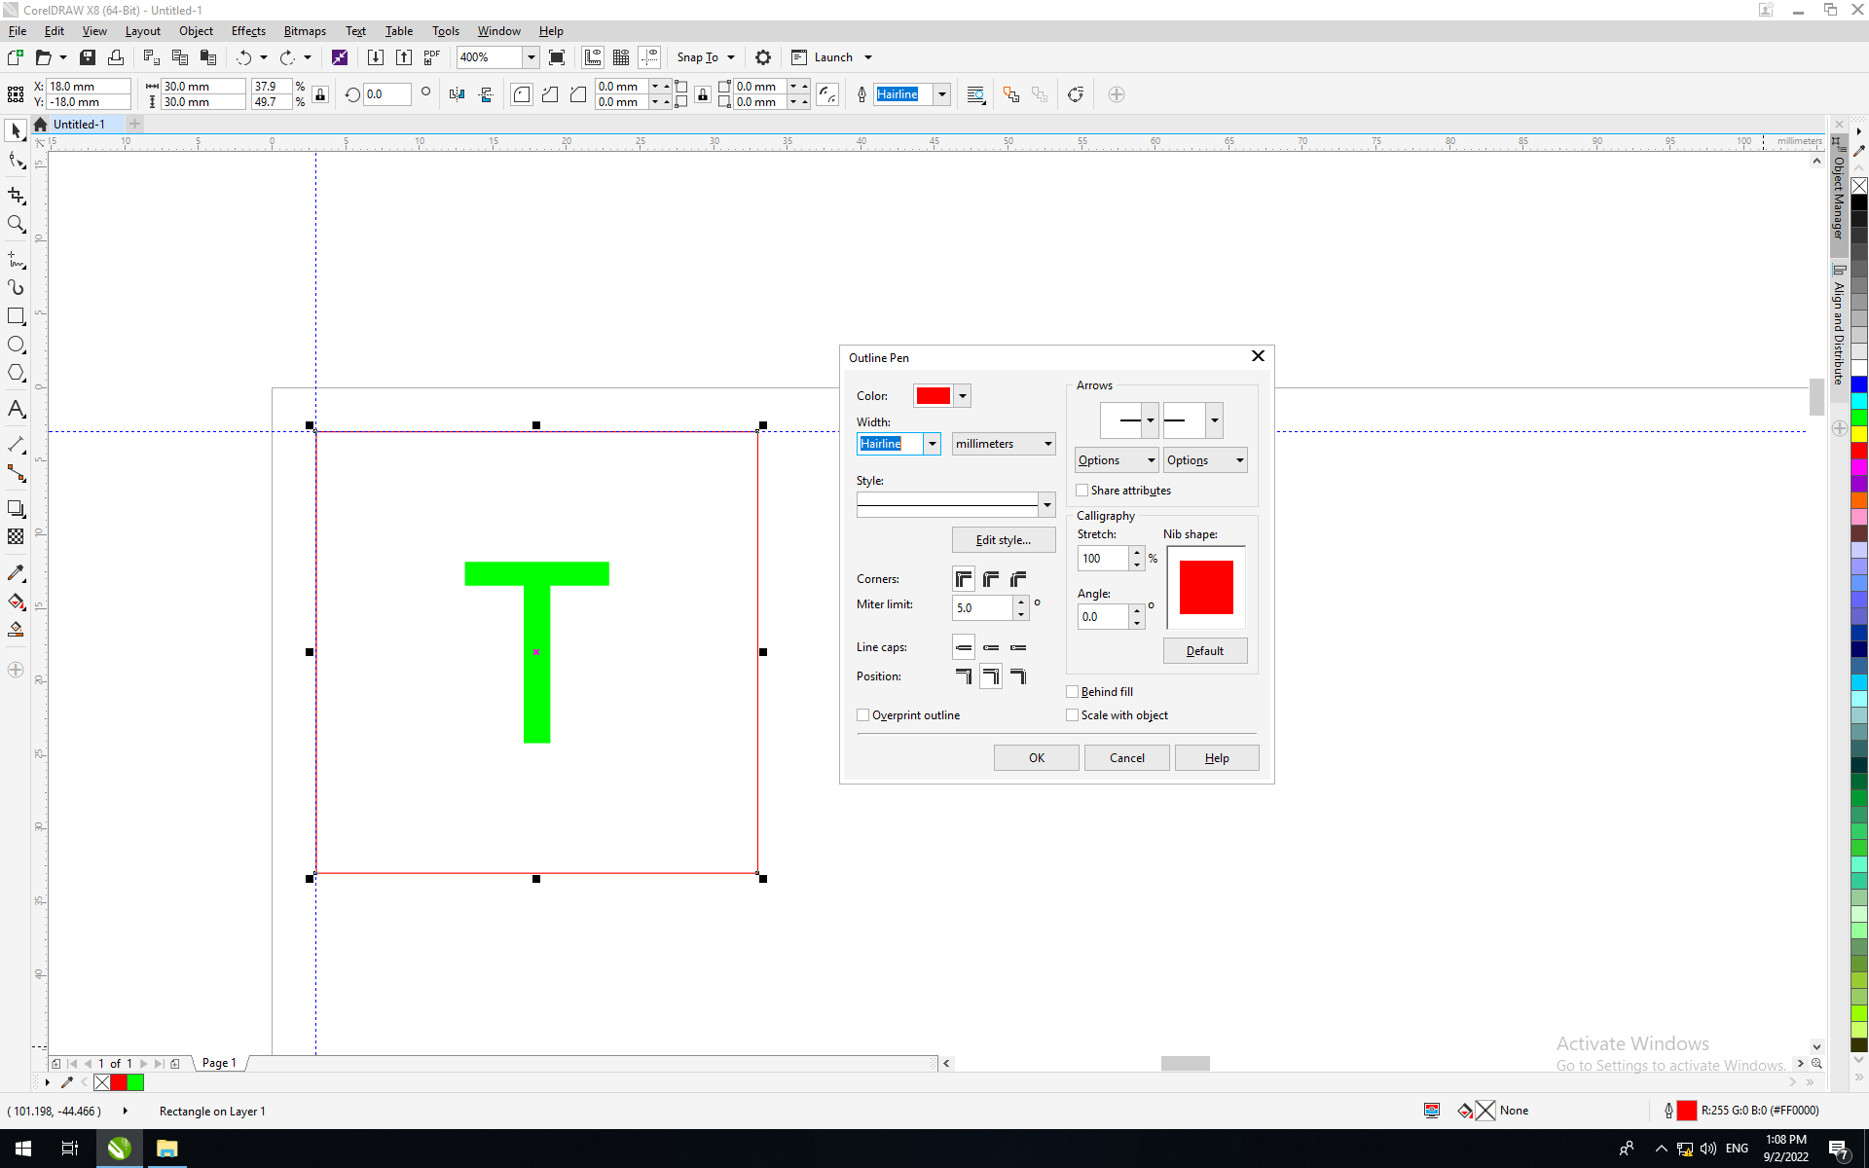
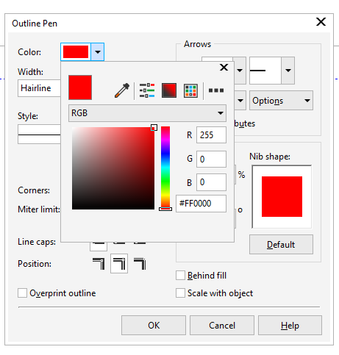
Step 7
You can change the outline color, infill color and line thickness of your line(s) and object(s) by clicking twice at the two icons at the bottom right.
LINE COLOUR
LINE THICKNESS
CHANGE INFILL COLOUR
CHANGE OUTLINE COLOUR
COLOUR FORMATE SHULD BE IN RGB
The object was meant to cut; therefore, red was set at the maximum and the rest were set at zero.

Slide 10
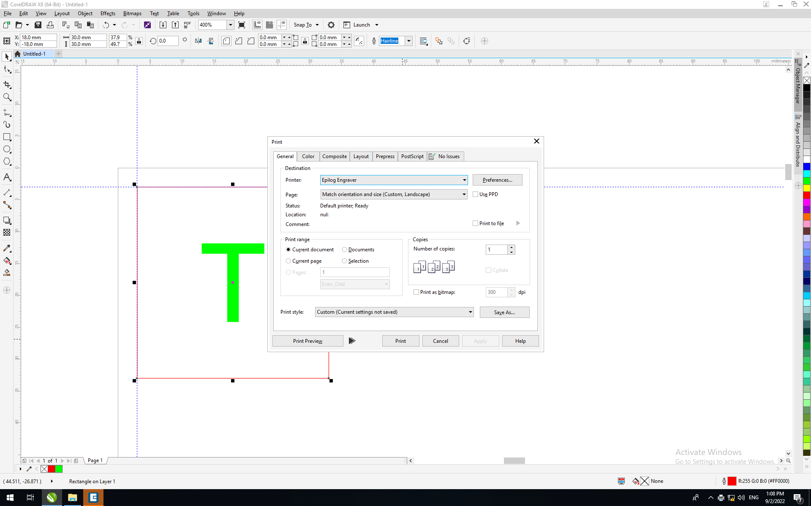
Step 8
When the drawing is ready for printing click “Print”. You should be led to a new program. If the program does not open automatically, find “Epilog Job Manager” from the desktop and manually open it. Then go back to CorelDraw and print again.

Slide 11
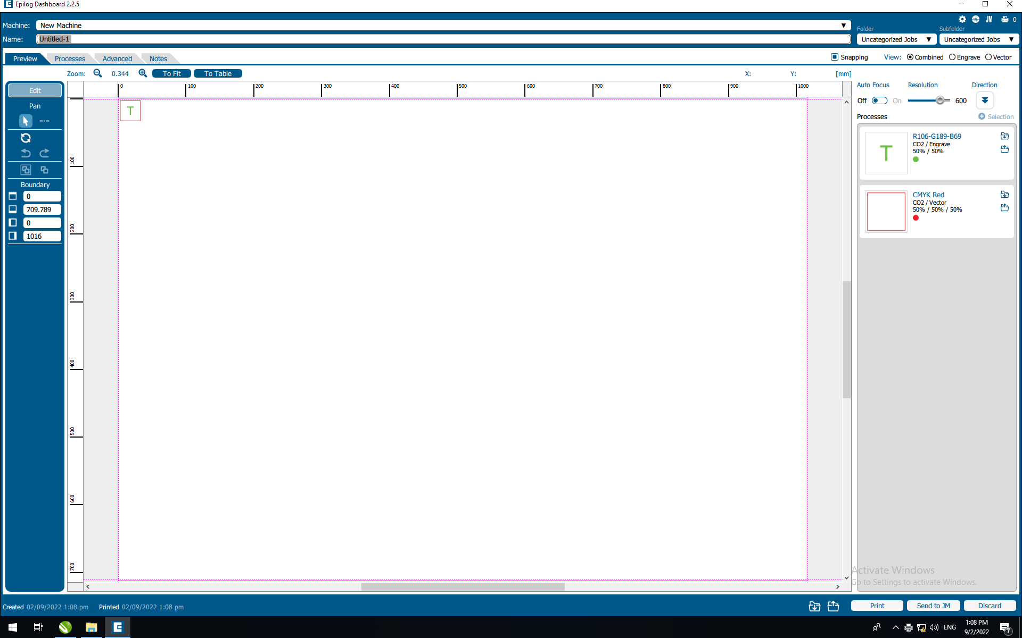
Step 9
Epilog Job Manager will open, and you will see a display like this. Then click “Import Settings”.
Note: If you cannot find your drawing on the canvas, check CorelDraw again. Make sure that your drawing has the correct cutting settings, correct line thickness and colors.
IMPORT SETTINGS

Slide 12
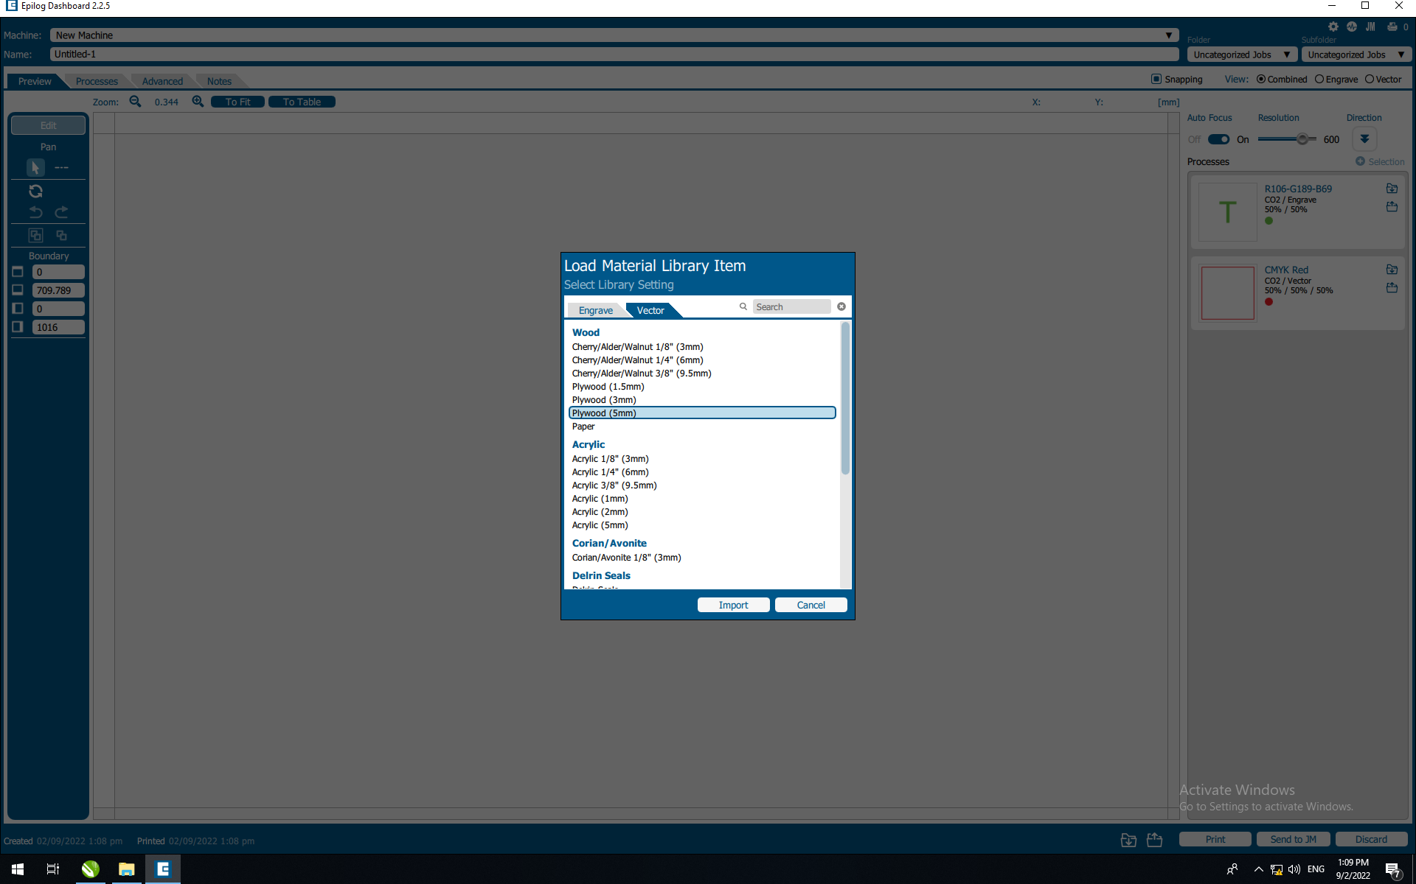
Step 10
You will see a list of materials. Select the material that you are using. Here, “Plywood (5mm)” has been chosen for example.

Slide 13

Step 11
Make sure that “Auto Focus” has been turned on. Check your settings and thickness. Make sure that “Air Assist” is on. You can edit “Cycles” if you want to cut the same vector multiple times.

Slide 14

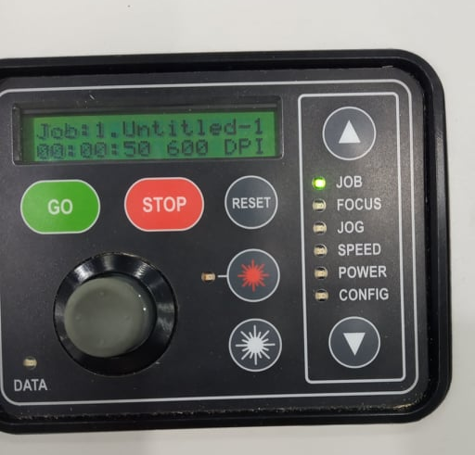
Step 12
After everything has been checked, click “Print”. Your job will be sent to the laser cutter. You can see your job title and cut time on the machine display.
JOB TITLE (ABOVE) AND CUTTING TIME (BELOW)

Slide 15
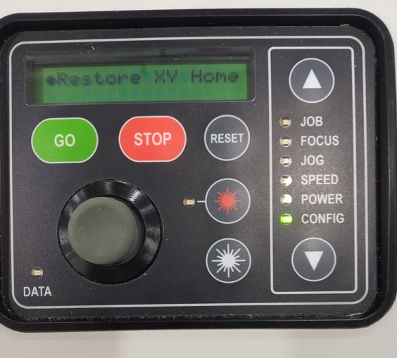
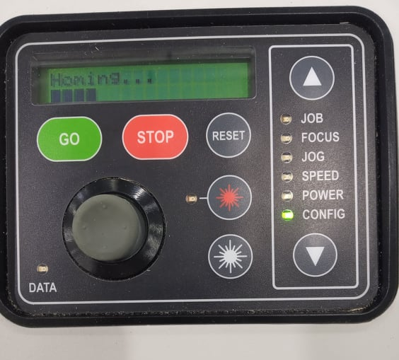
Step 13
Before you start cutting, go to “CONFIG” using the down button and click the jog stick. It will home the XY coordinate on the machine. This prevents the machine from start cutting from the wrong position. Wait until the homing has finished.
2
1

Slide 16
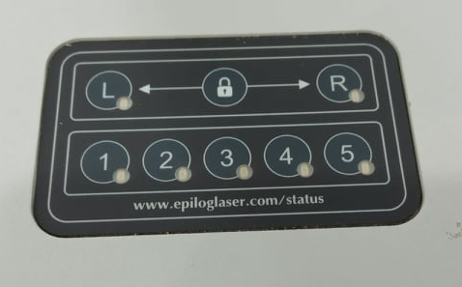
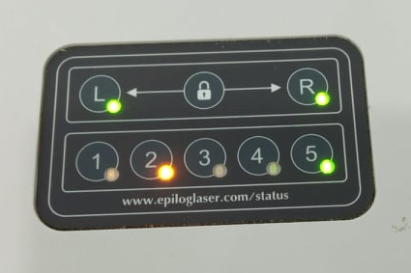
Step 14
When everything is ready, go to “JOB” and click “GO”. Make sure that the cover of the laser cutter has been closed before cutting. Otherwise, it will only perform an air-cut. You can see the light has been turned on when the cover has been completely closed.
Door Open
Door Close

Slide 17
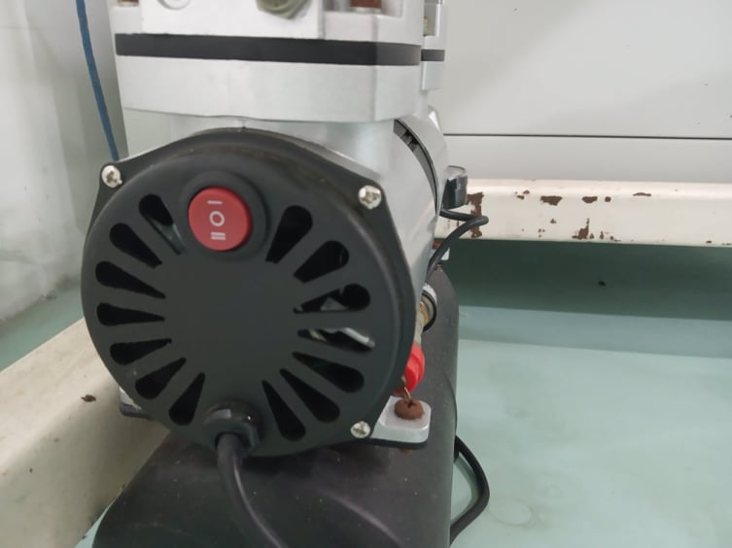
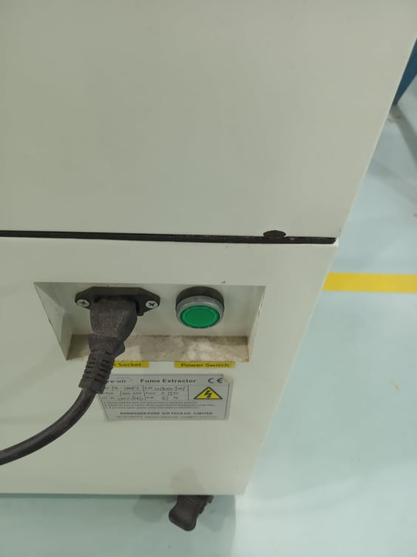
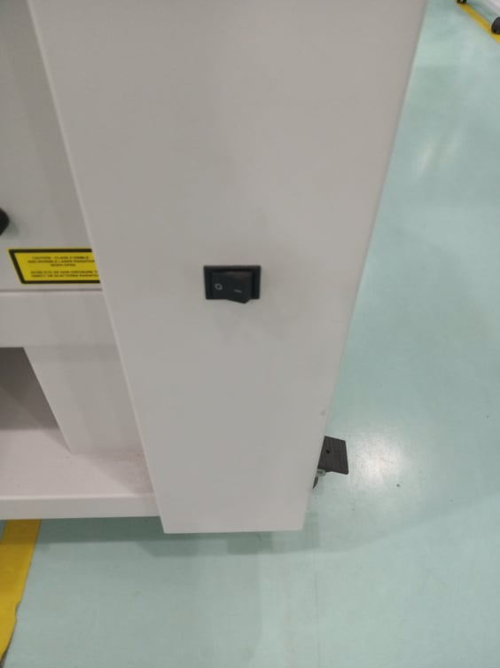
Step 15
After everything is done, make sure that the machine bed is clear of every debris, throw away all the rubbish and the area is clear. Double check to see whether all the powers have been switched off.

Slide 18
General Rules and Precautions to Take Note-
Do not stare at the laser for long periods of time. Exposure to radiation can damage your eyes.
Do not leave the laser cutter unattended during operation. Laser produces a lot of heat. Fire can break out during cutting and engraving process.
When you see flames during laser cutting, open the cover quickly, which will pause the process, and take out the fire.
After cutting is finished, do not open the cover immediately. Wait for about 10-20 seconds for the smoke to clear.
When cutting acrylic, peel off the top cover sheet as the sheet can catch fire.
Do not slam shut the laser cutter cover. Slowly pull it down.
If you encounter a problem, find the staff in charge or a lecturer. Do not try to resolve the issue if you are not familiar with the laser cutter.
Do not leave the remaining materials lying around in the area. Return it to the dedicated recycle station or find the lab staff for help.
If the materials cannot be used, throw them in the rubbish bin. Do not put those in the recycle drawers as they are not rubbish bins.
Note:
Failure to follow the rules and precautions can cause in injury and property damage. You will also be banned from using the equipment for a certain period of time.

Slide 19
End of Guide
Thank you

